Slide 1
Week-8
Session-2
Understanding Accounting and Financial Information

Slide 2

ACCOUNTING VS. FINANCE

Slide 3
WHAT’S ACCOUNTING?
*
*
Accounting -- Recording, classifying, summarizing and interpreting of financial events and transactions in an organization to provide interested parties needed financial information.
Finance (Financial Management)-- It is concerned with the ways in which funds for a business are raised and invested.
17-

Slide 4
Raise Funds
Use Funds
Owners, Lenders
Investments (Equipment, premises etc.)

Slide 5
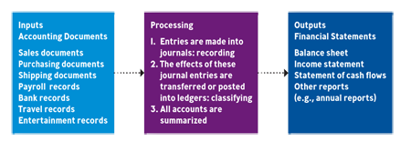
The ACCOUNTING SYSTEM
*
*
17-

Slide 6
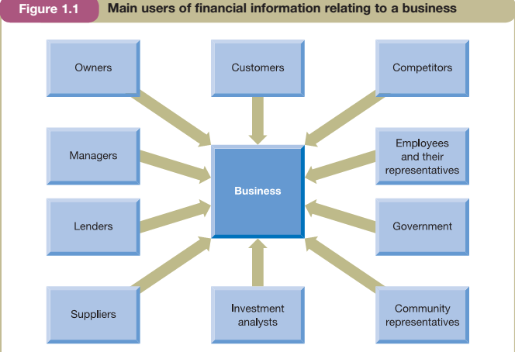
Who are the users of Accounting Information
The accountant must be clear for whom the information is being prepared and for what purpose the information will be used.

Slide 7
The conflicting interest of users
Interest of various groups may collide
Although managers are appointed to act in the best interests of the owners, they may not always do so.
There is also a potential collision of interest between lenders and owners

Slide 8
Management Accounting & Financial Accounting
Management accounting - seeks to meet the accounting needs of managers
Financial accounting- seeks to meet those of all of the users identified earlier in except for managers

Slide 9
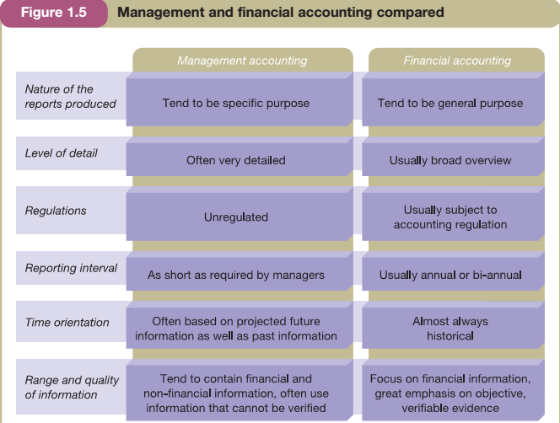
Management & Financial Accounting

Slide 10

FINANCIAL STATEMENTS
*
Understanding Key Financial Statements
*
LG3
Financial Statement -- A summary of all the financial transactions that have occurred over a particular period.
Key financial statements of business are:
  Statement of financial position (Balance sheet)
  Income statement (known as profit and loss account)
  Statement of cash flows
17-

Slide 11
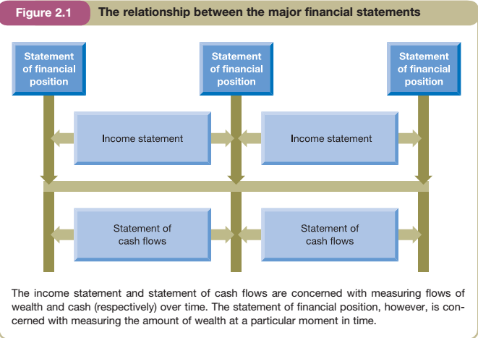

Slide 12
The Income statement
Revenue: simply a measure of the inflow of economic benefits arising from the ordinary operations of a business.
Some examples
Sales of Goods
Fees for services
Subscriptions
Interest received
Cost of Sales: how much it costs to produce a good or service

Slide 13
The Income statement
Operating Expenses
Depreciation: depreciation is an attempt to measure that portion of the cost (or fair value) of a non-current asset that has been depleted in generating the revenue recognized during a particular period.

